Slide 1
Projectile Motion

Slide 2
What is a Projectile?
If we ignore air resistance, a projectile is an object upon which the only force acting is gravity.
This could mean dropping a rock, throwing a ball straight up or kicking a football. The rock, ball and football are all projectiles.

Slide 3
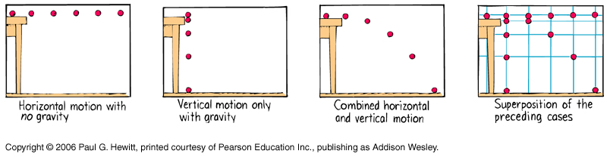
What is Projectile Motion?
Projectile motion is a combination of uniform horizontal and freefall vertical motion

Slide 4
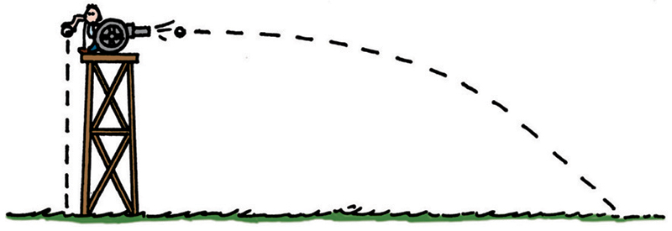
Test Your Thinking
At the instant a cannon fires a cannonball horizontally over a level range, another cannonball held at the side of the cannon is released and drops to the ground.
Which strikes the ground first?

Slide 5
Cannon balls
One ball is released and falls straight down.
Other ball is fired horizontally.
At all times the balls are at the same height.
They hit the ground at the same time.
FALL
1
FIRE
1
2
1
2
3
3
3
5
4
4
8-Feb-24

Slide 6
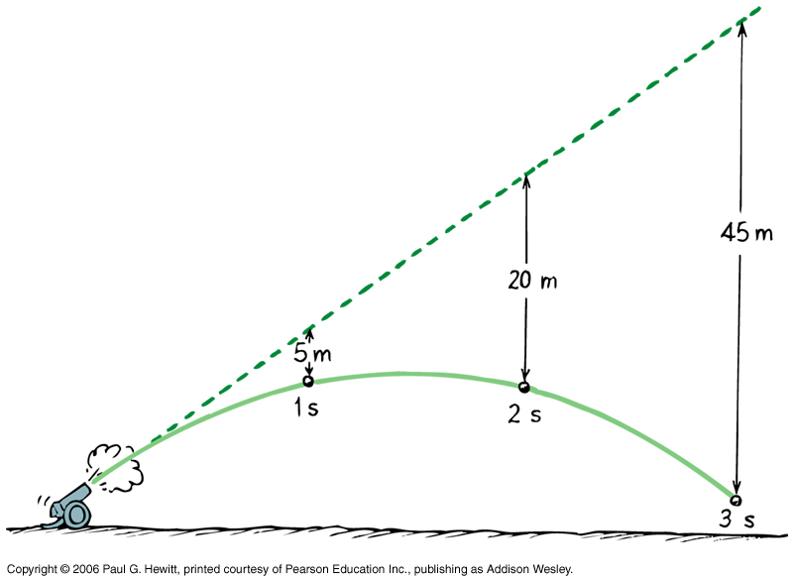
Projectiles launched at an angle
With no gravity, the projectile would follow a straight line.
Due to gravity, the projectile falls below this line in the shape of a parabola.

Slide 7
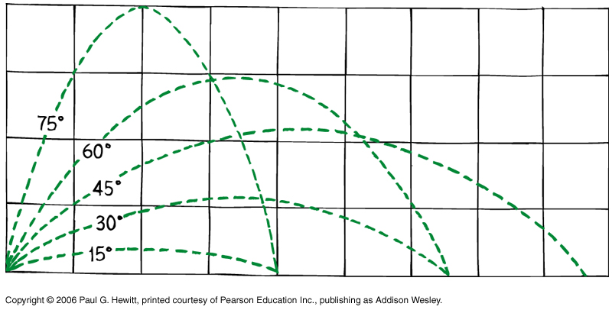
Maximum Range
The maximum range of a projectile is at a 45º angle when no air resistance is present.

Slide 8
Air Resistance
If a projectile is effected by a head wind, the horizontal range will decrease.
If a projectile is effected by a tail wind the horizontal range will increase.

Slide 9
Projectile Motion Questions
The first step in tackling projectile motion questions is to draw a picture. Don’t worry about the calculations yet… just draw a detailed, labelled picture of the information given.
Then transfer this information to a data key – now you are ready to tackle the calculation.

Slide 10
Projectile Motion Calculations
The first step to completing projectile motion calculations is to remember that the motion is occurring in two components, horizontally and vertically.
As a result these two components must be calculated separately.

Slide 11
Initial Velocity
The initial velocity, u_{O} of the projectile is the resultant vector of the horizontal and vertical components of the initial velocity.
u_{O}
u_{V}
θ
u_{H}

Slide 12
Initial Horizontal and Vertical Components of Velocity
By using trigonometry you can work out that: The initial horizontal velocity u_{H} is:
u_{H} = u₀cosθ
The initial vertical velocity u_{V} is:
u_{V} = u₀sinθ

Slide 13
What’s next?
All projectile motion calculations use the exact same movement formulas you learnt in Year 11 Physics. The major difference is that these formulas can only use values from one component i.e. either the vertical component or the horizontal component NOT both!

Slide 14
Motion formulas revisited
There are three main motion formulas:
v² = u² + 2as
v = u + at
s = ut + ½at²
a is the acceleration due to gravity which is 9.80ms⁻²

Slide 15
Vertical component formulas
When using the formulas in the vertical component, assume that all downward values are negative. This makes the formulas become:
v_{v}² = u_{v}² - 19.6s_{v}
v_{v} = u_{v} - 9.8t
s_{v} = u_{v}t - 4.9t²

Slide 16
Horizontal Component Formulas
There is no horizontal acceleration. As a result the Initial horizontal velocity is equal to the Final horizontal velocity.
This means there is really only one formula we can use for the horizontal component:
s_{H} = u_{H}t
The other part of the formula has been removed as it would return a value of zero.

Slide 17
Things to remember
Time is the same in the horizontal and vertical components
At the top of the parabola, the vertical velocity is zero.
You can not calculate the vertical or horizontal displacement using trigonometry. You must use the motion equations to calculate this.

Slide 18
A helpful table
Variable | Vertical Component | Horizontal Component
Acceleration (a) | -9.80ms⁻² | 0ms⁻²
Initial Velocity (u)
Final velocity (v)
Displacement (s)
Time (t)

Slide 19
A Very Easy Question
Brian was practising golf at a driving range. He was on an elevated tee 6.0m above the fairway and struck a ball so that it left his club with an initial horizontal velocity of 25.0ms⁻¹.
How long after the ball leaves the club, will it land on the fairway?
What horizontal distance will the ball travel before striking the fairway?

Slide 20
Step 1 – Draw a picture
u_{H} = 25.0ms⁻¹
s_{v} = -6.0m

Slide 21
Step 2 – Data key
Variable | Vertical Component | Horizontal Component
Acceleration (a) | -9.80ms⁻² | 0ms⁻²
Initial Velocity (u) | 0ms⁻¹ | 25.0ms⁻¹
Final velocity (v)
Displacement (s) | -6.0m
Time (t)

Slide 22
Use the data to answer the questions
Use the formula:
s_{v} = u_{v}t - 4.9t²
-6.0 = 0.t – 4.9t²
-6.0 = -4.9t²
-6.0/-4.9 = t²
t² = 1.22
t = 1.11s

Slide 23
Step 2 – Data key
Variable | Vertical Component | Horizontal Component
Acceleration (a) | -9.80ms⁻² | 0ms⁻²
Initial Velocity (u) | 0ms⁻¹ | 25.0ms⁻¹
Final velocity (v)
Displacement (s) | -6.0m
Time (t) | 1.11s

Slide 24
Use the data to answer the questions
Use the formula:
s_{H} = u_{H}t
s_{H} = 25.0 x 1.11
s_{H} = 27.7m

Slide 25
A little more complicated question
Blake kicked a soccer ball off the ground at an angle of 30 degrees at 22.0ms⁻¹.
What is the maximum height the ball will reach?
Calculate the horizontal range of the soccer ball kick.

Slide 26
Step 1 – Draw a picture
u_{O} = 22.0ms⁻¹
θ = 30º

Slide 27
Step 2 – Data key
Variable | Vertical Component | Horizontal Component
Acceleration (a) | -9.80ms⁻² | 0ms⁻²
Initial Velocity (u)
Final velocity (v)
Displacement (s)
Time (t)

Slide 28
Step 3 – Calculate initial component velocities
The initial horizontal velocity u_{H} is:
u_{H} = u₀cosθ
= 22.0cos30
= 19.1ms⁻¹
The initial vertical velocity u_{V} is:
u_{V} = u₀sinθ
= 22.0sin30
= 11ms⁻¹

Slide 29
Step 2 – Data key
Variable | Vertical Component | Horizontal Component
Acceleration (a) | -9.80ms⁻² | 0ms⁻²
Initial Velocity (u) | 11.0ms⁻¹ | 19.1ms⁻¹
Final velocity (v)
Displacement (s)
Time (t)

Slide 30
Step 4 – Use the data to answer the questions
At maximum height, the vertical velocity is zero, so use the equation:
v_{v}² = u_{v}² - 19.6s_{v}
0 = 11² -19.6s_{v}
19.6s_{v} = 121
s_{v} = 121/19.6
= 6.17m

Slide 31
Step 4 – Use the data to answer the questions
To find the range of the soccer ball we need to know how long its trajectory lasted. We can calculate this by finding out how long it would take for the ball to reach the top of its trajectory and then multiplying the answer by two. This can be done because this particular parabola is symmetrical.

Slide 32
Step 4 – Use the data to answer the questions
Use the equation:
v_{v} = u_{v} - 9.8t
0 = 11 – 9.8t
9.8t = 11
t = 11/9.8
t = 1.12s for half parabola
t = 2.24s for entire range

Slide 33
Step 4 – Use the data to answer the questions
Now we can use the formula:
s_{H} = u_{H}t
s_{H} = 19.1 x 2.24
s_{H} = 42.9m
* Make sure you use exact calculator values in your calculations.. not your rounded values.

